Slide 1
Does Creativity matter in religious world views?
1. Can I understand how art can show identity and belonging?

Slide 2



Can you recall some ways that humans communicate?
Not all communication is through language.
Think back to our last unit.
Notes:
speaking and writing
music
art and pictures
signs and symbols

Slide 3
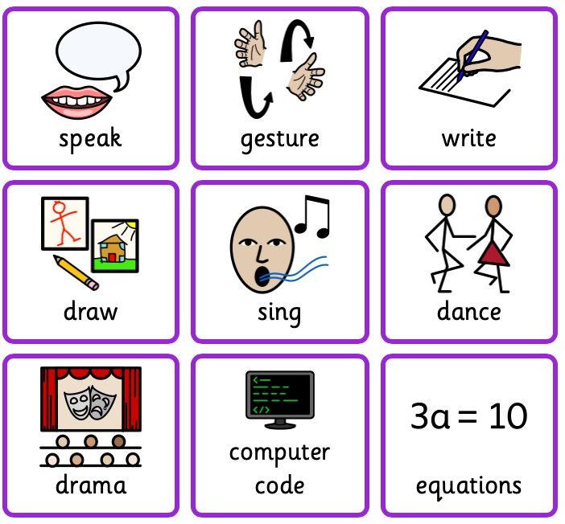
How do we communicate?
Notes:
Watch the video and read text to answer questions in their books.

Slide 4
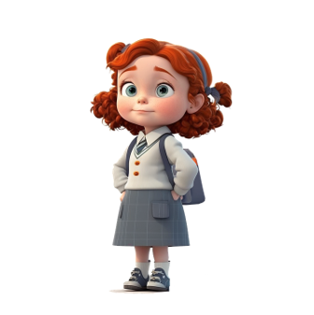
Who am I?
Why am I here?
Notes:
Children discuss these with a partner.
Use simple prompts:
What makes you who you are?
Which groups do you belong to?
What is important to you?
Would everyone give the same answer? Why?
Explain that people’s answers may be different because they have different families, communities and experiences.

Slide 5
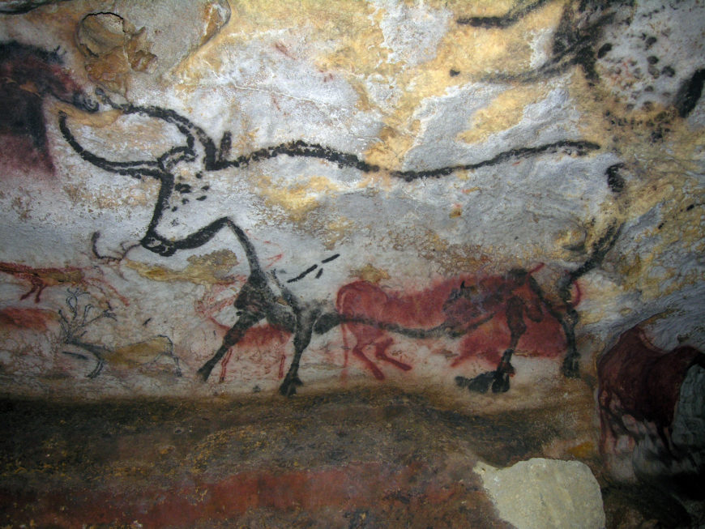
Lascaux caves in France 16,000 BC
What can you see?
What does it tell us?
Why would people have made it?
https://www.youtube.com/watch?v=74woCKzVEIc
Notes:
Watch the video and discuss how in ancient times, people used art to express themselves and show who they were.

Slide 6
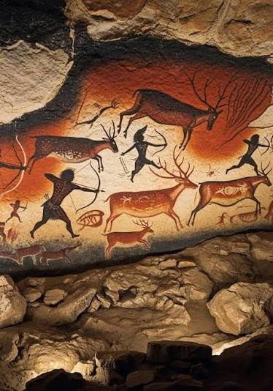
Lascaux caves in France 16,000 BC
What can you see?
What does it tell us?
Why would people have made it?
Notes:
Watch the video and discuss how in ancient times, people used art to express themselves and show who they were.

Slide 7
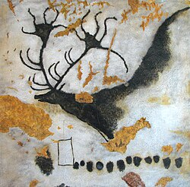
Lascaux caves in France 16,000 BC
What can you see?
What does it tell us?
Why would people have made it?
Notes:
Watch the video and discuss how in ancient times, people used art to express themselves and show who they were.

Slide 8
Challenge: Can you create a piece of art to show who you are?
You could include symbols to show:
Your family and important people
A hobby or interest
A group or community
Something you value
Notes:
Play charades and discuss the challenges.

Slide 9
Challenge: Write a short description to go with this.
My artwork shows…
I included… because…
This symbol represents…
This shows that I belong to…
Notes:
Play charades and discuss the challenges.

Slide 10
Who am I?
Why am I here?
Notes:
Children discuss these with a partner.
Use simple prompts:
What makes you who you are?
Which groups do you belong to?
What is important to you?
Would everyone give the same answer? Why?
Explain that people’s answers may be different because they have different families, communities and experiences.

Slide 11
Cave art tells us more about communities than individual people.
I agree because…
I disagree because…
Notes:
Do they agree or disagree?
Why?

