Slide 1
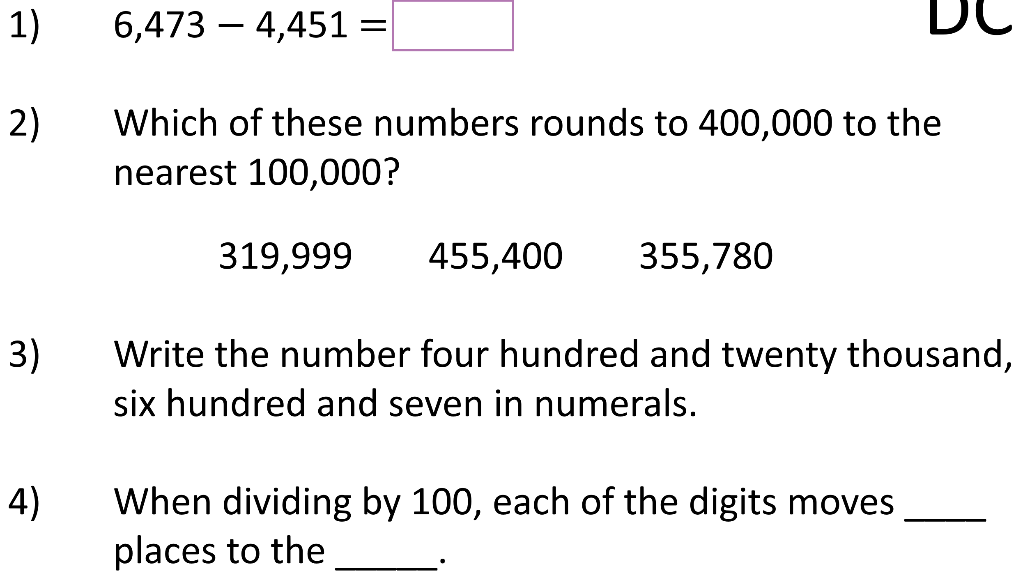
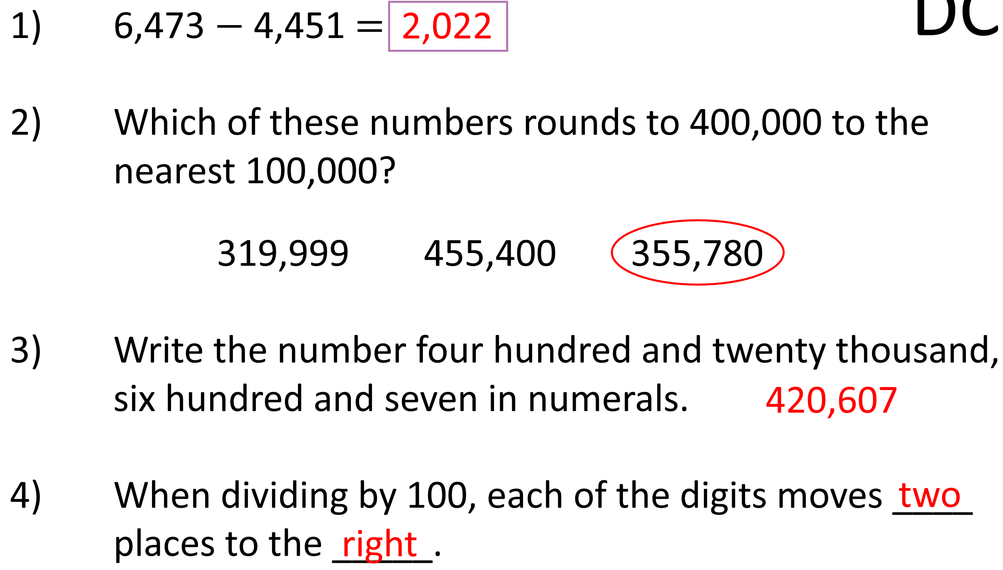
Retrieval

Slide 2
Learning Intention
Stem Sentence…
Write the largest factor
Write the smallest factor below, lining up the digits
Multiply starting with the ones
Regroup and add from regroup
Multiply the tens
Regroup and add from regroup
Vocabulary…
Estimate
Estimation
Find a value that is close enough to the right answer
Links to learning ahead…
To multiply a three-digit number by a single-digit number using partitioning and representations.

Slide 3
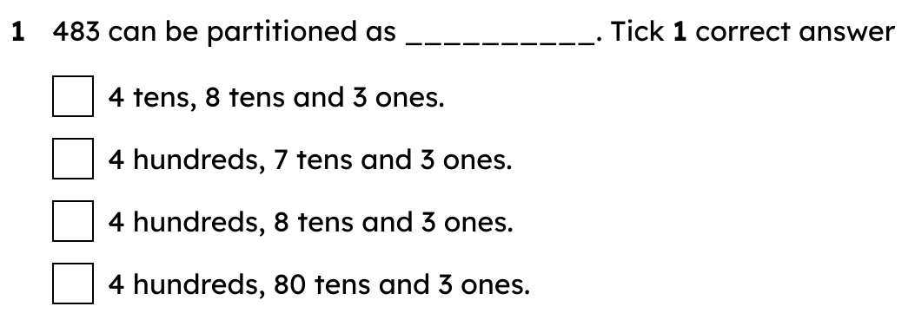
Starter

Slide 4
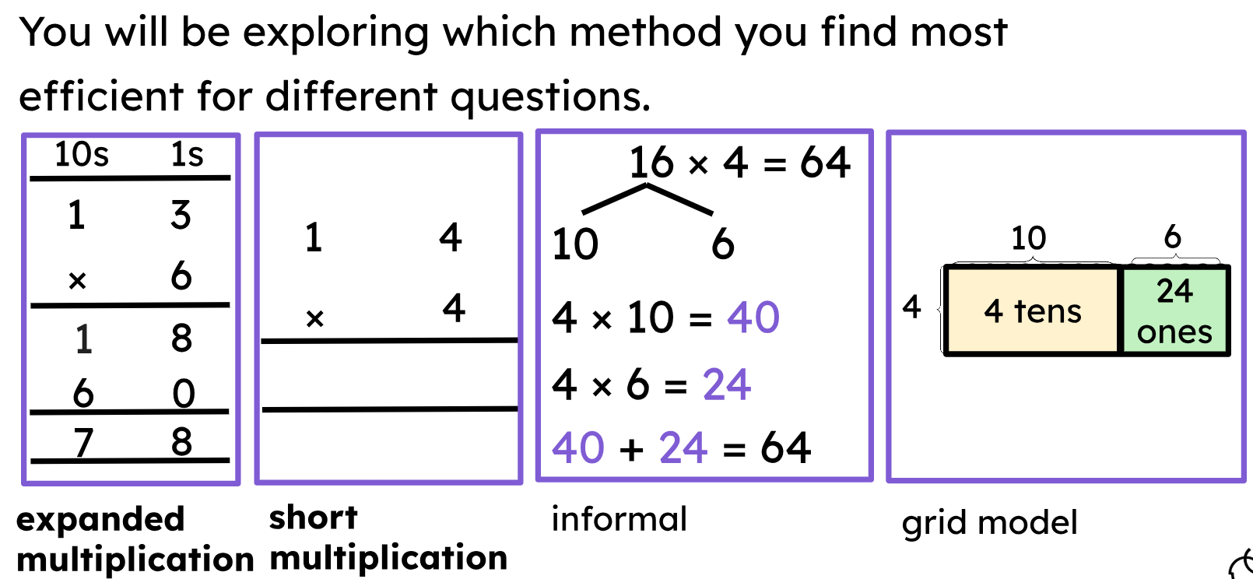
Explore & Notice

Slide 5
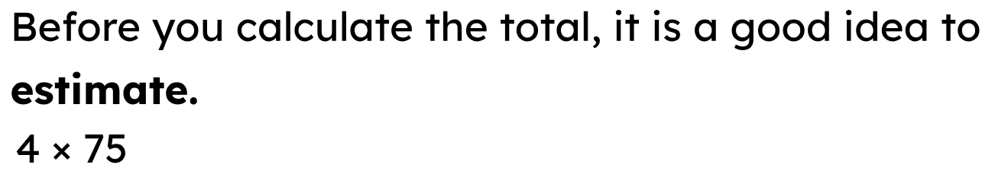


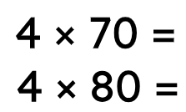
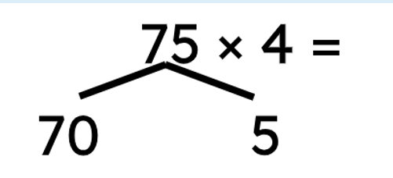
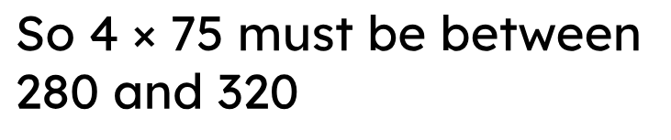
CPA

Slide 6
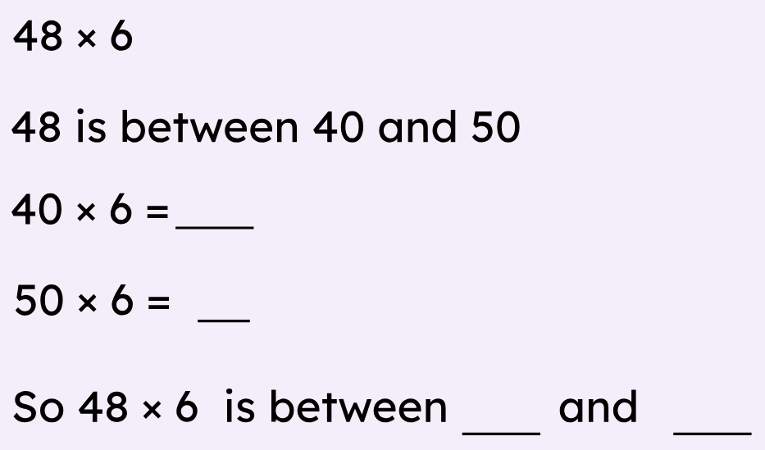
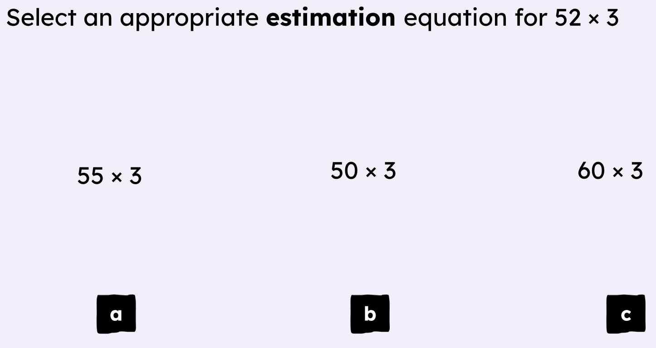

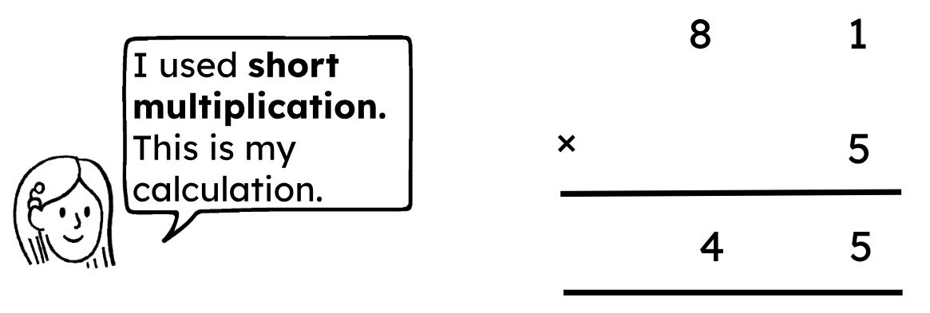
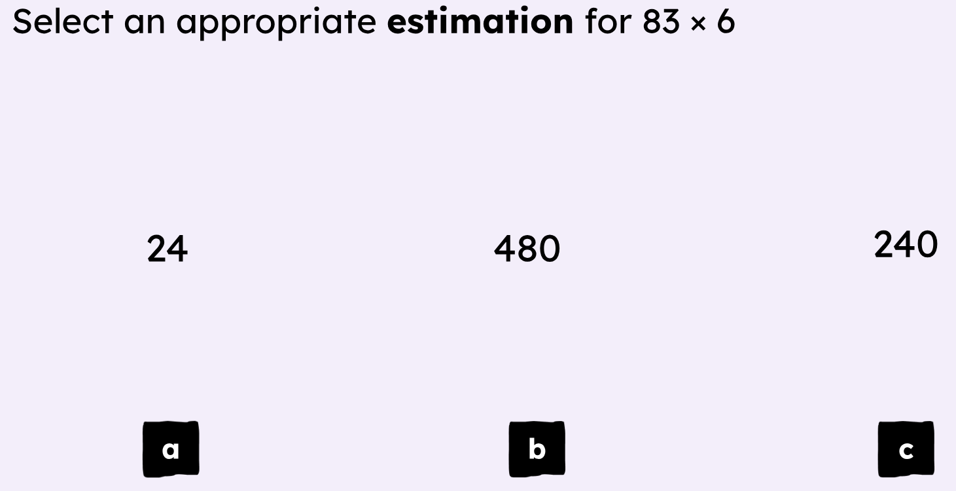
CPA

Slide 7
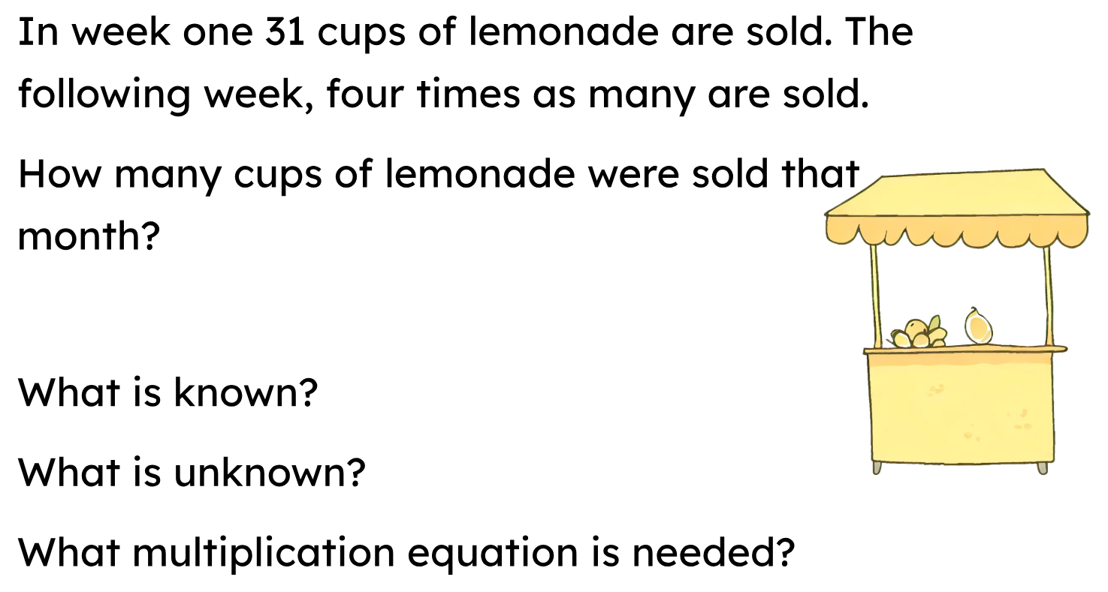

CPA

Slide 8
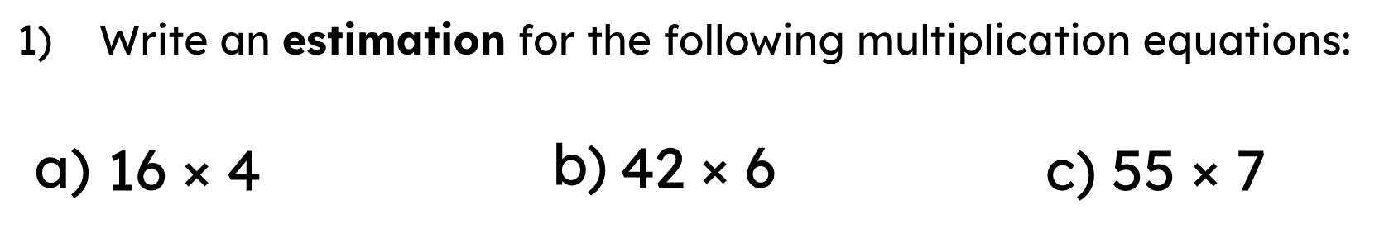
Independent Practice

Slide 9
Independent Practice

